Slide 1
World Day Against Child Labour
Say No to Child Labour – Yes to Education!"

Slide 2
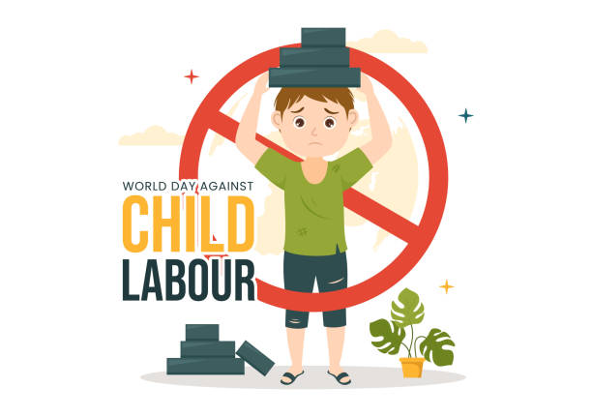
What is Child Labour?
Child labour is work that harms the physical, mental, and emotional well-being of children.
It prevents children from attending school and enjoying a normal childhood.

Slide 3
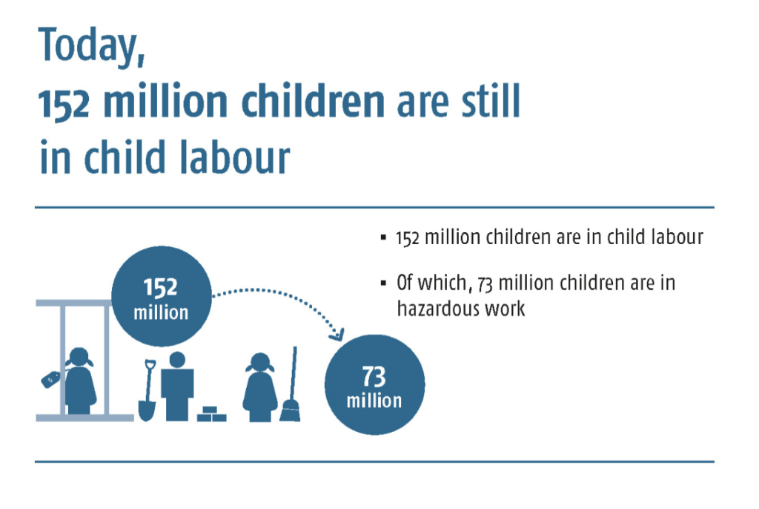
Why Does Child Labour Exist?
Poverty and unemployment.
Lack of education and awareness.
Demand for cheap labour.
Weak law enforcement in some areas

Slide 4

Role of Government Authorities
. Ministry of Labour and Employment (India)
Enforces child labour laws
Runs rehabilitation programs
2. National Commission for Protection of Child Rights (NCPCR)
Monitors child rights
Acts against child exploitation
3. State Labour Departments
Conduct inspections
Rescue and rehabilitate child labourers
4. Police & Child Welfare Committees (CWC)
Investigate and take action
Ensure safe custody and education

Slide 5
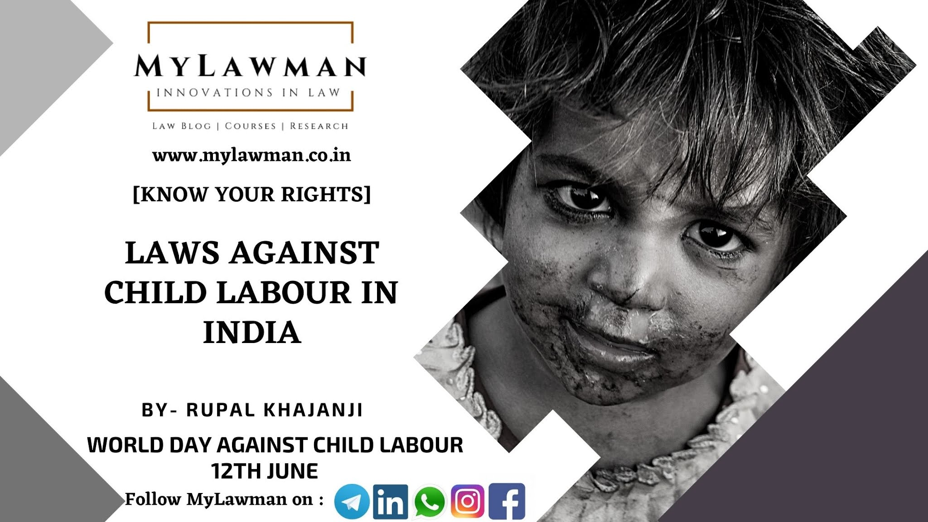
Laws Against Child Labour
Child Labour (Prohibition and Regulation) Act, 1986
Prohibits employment of children below 14 years
Right to Education Act, 2009
Free and compulsory education for children aged 6–14
Juvenile Justice (Care and Protection) Act, 2015
Punishes those who employ children illegally

Slide 6

What Can We Do?
Spread awareness among family and friends.
Support NGOs and government schemes.
Report child labour to authorities (e.g., Childline 1098).
Encourage education and community action

Slide 7
Conclusion
Let’s work with the government and society to stop child labour.
Every child deserves a safe, happy, and educated life “Children should hold books, not tools.”

Slide 8
THANK YOU
Let children be children, not laborers." ✨

